Slide 1
Cities of Russia

Slide 2
Introduction
The idea of ​​my research is to help people, who want to change their place of residence
This study will be useful to those who want to move to another city; real estate agencies of individual cities, in addition, it may become a takeover for changes in troubled cities:
People who plan to change their place of residence will be able to visually assess the capabilities of individual cities.
Real estate agencies will be able to use the results of research to advertise real estate in individual cities.
City leaders can get a clear picture of the state of their city.

Slide 3
Data
location of cities;
ecological situation in cities;
the population growth rate of the city (what is the trend?: more come or leave the city)
cost of housing.
Data sources:
https://showdata.gks.ru/report/279006/
https://www.domofond.ru/statya/ekologicheskiy_reyting_200_gorodov_rossii_za_2019_god/100219
https://rosrealt.ru/cena/kvartira

Slide 4
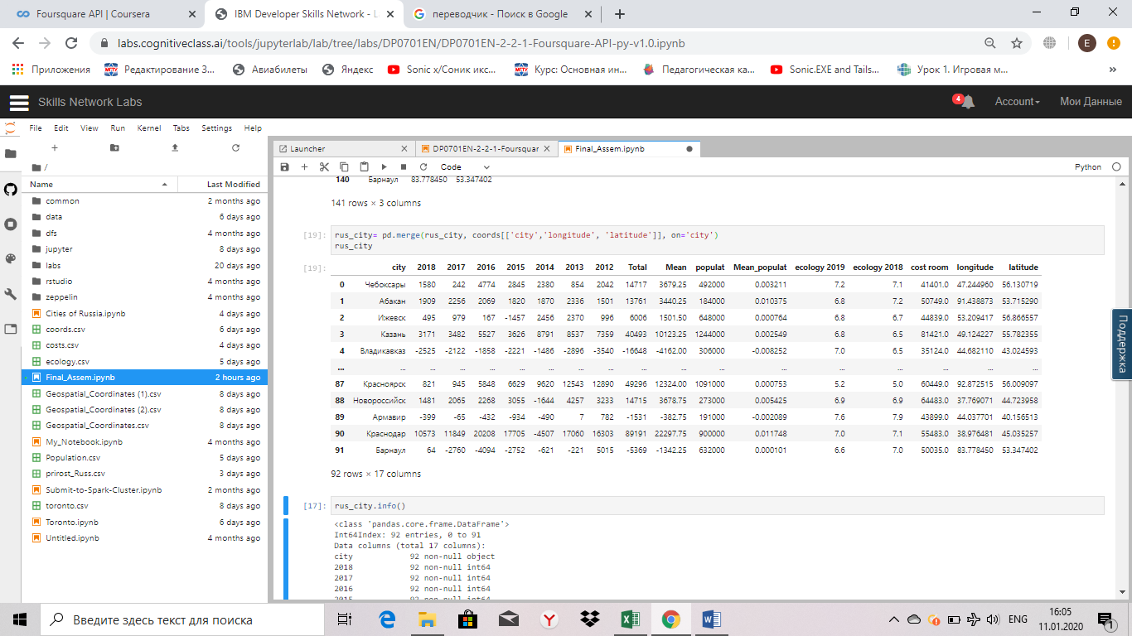
The first dataframe
Сities of Russia with a population of more than 100,000 people

Slide 5
Methodology
Pearson Correlation Coefficient
P-value of P
K-Means Clustering

Slide 6
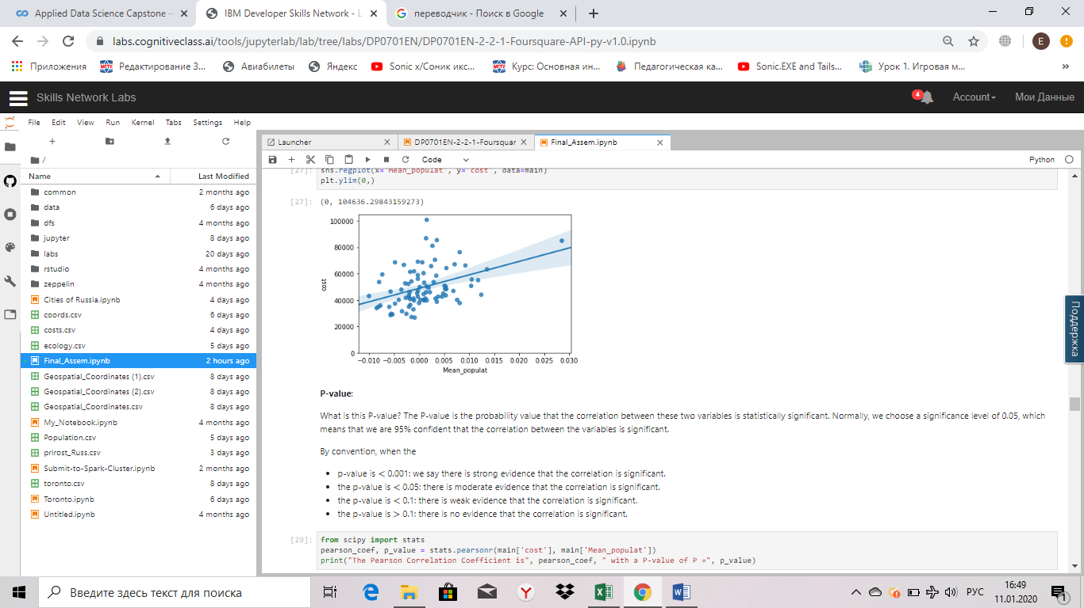
Correlation between population migration and the cost of housing
The Pearson Correlation Coefficient is 0.39808265294779915
with a P-value of P = 0.00013429244814229738

Slide 7
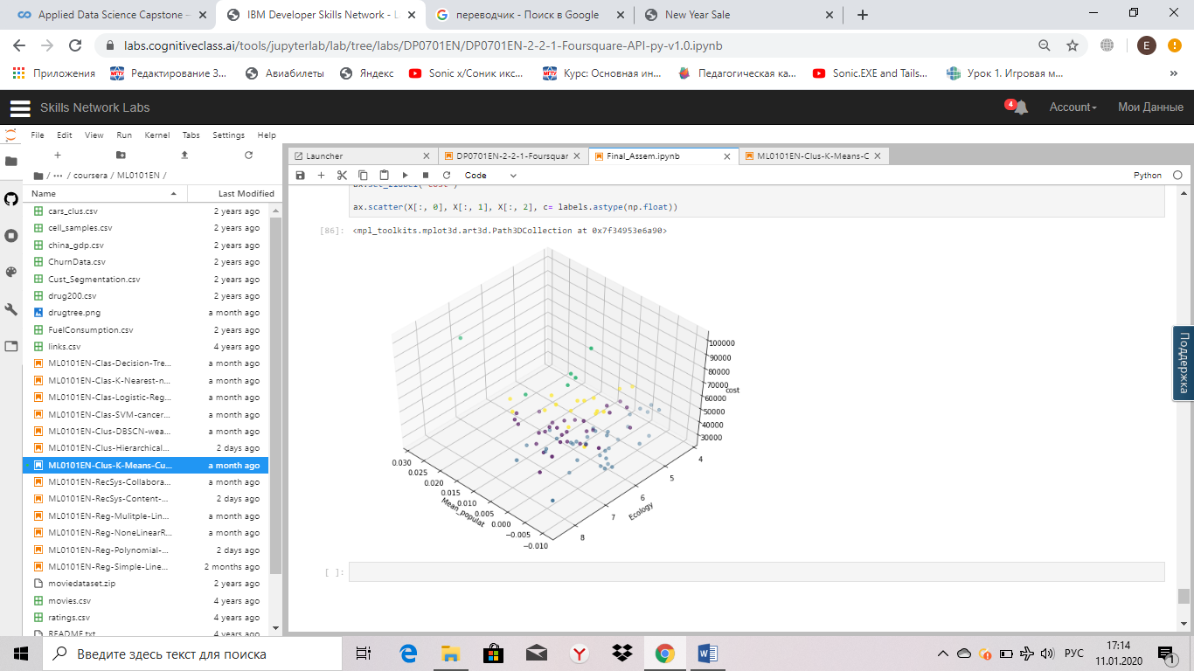
K-Means Clustering

Slide 8
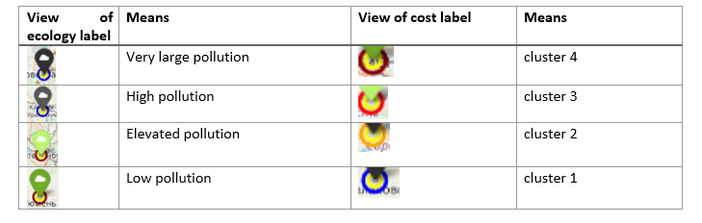
Visualize information on the environmental situation
All cities were divided into 4 categories according to the ecological situation:
Ecology <= 5.9 - Very large pollution
5.9 < Ecology <= 6.3 - High pollution
6.3< Ecology <= 6.9 - Elevated pollution
Ecology >6.9 - Low pollution
We also divided all cities into 4 clusters according to the cost of housing:
cost <= 40285 - "cluster 1"
40285 < cost <= 46625 - "cluster 2"
46625< cost <= 58772 "cluster 3"
cost > 58772 "cluster 4"

Slide 9
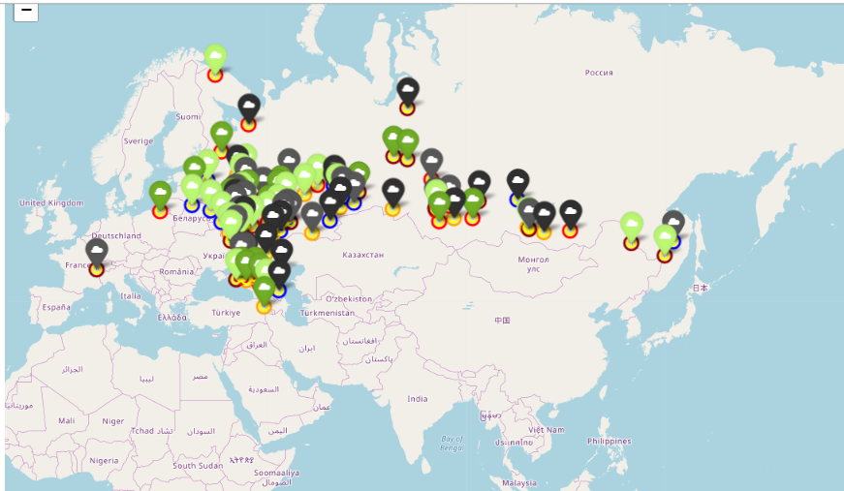
Folium

Slide 10
Results
Analyzing the mark data on the map, we saw that for our family the following cities would be most preferable for moving:
Vladimir,
Saransk,
Cheboksary,
Pskov.

